Slide 1
Playlist Manager
Using Doubly Linked List | C++
Data Structures
C++
DSA Project
Implemented with head / tail / current pointers
github.com | C++ | DSA

Slide 2
What is a Doubly Linked List?
Each node stores data + a pointer to the NEXT node + a pointer to the PREV node.
head
Song A
Song B
Song C
tail
→
→
→
→
←
←
←
←
→ next pointer ← prev pointer
Why use it for a Playlist Manager?
✦ Navigate forward and backward between songs easily
✦ Efficiently insert and delete songs at any position
✦ Maintain a 'current song' pointer for real-time playback
✦ No fixed size — playlist grows and shrinks dynamically

Slide 3
Node Structure & Global Pointers
struct Song {
What each pointer does:
string title;
title
Stores the song name (string)
Song* next;
next →
Points to the next song in playlist
Song* prev;
};
prev ←
Points to the previous song
Song* head = NULL;
head
Always points to the first song
Song* tail = NULL;
tail
Always points to the last song
Song* current = NULL;
current
Tracks the currently playing song

Slide 4
Algorithm: Add Song
Steps
// Add Song
1. Start
void addSong(string name) {
2. Input song name
Song* n = new Song();
3. Create a new Song node
n->title = name;
4. Set next = NULL, prev = NULL
n->next = NULL;
5. If playlist is empty:
n->prev = NULL;
head = tail = current = node
if (head == NULL) {
head=tail=current=n;
6. Else:
} else {
tail→next = new node
tail->next = n;
new node→prev = tail
n->prev = tail;
tail = new node
tail = n;
7. End
}
}

Slide 5
Algorithms: Display | Play | Next | Previous
Display Playlist
Play Current
Next Song
Previous Song
Set temp = head
If current != NULL
If current != NULL
If current != NULL
If NULL → 'empty'
Print current title
AND next != NULL:
AND prev != NULL:
While temp != NULL:
Else:
current = current→next
current = current→prev
Print title
Print 'empty'
playCurrent()
playCurrent()
temp = temp→next
Else: 'No next song'
Else: 'No prev song'

Slide 6
Algorithm: Delete Song
Steps
void deleteSong(string name){
1. Input song name
Song* temp = head;
while (temp != NULL) {
2. Set temp = head
if(temp->title == name){
3. Traverse the list:
if(temp==head){
If song found:
head=temp->next;
If only 1 node:
if(head) head->prev=NULL;
head=tail=current=NULL
} else if(temp==tail){
tail=temp->prev;
If deleting head:
if(tail) tail->next=NULL;
head = head→next
} else {
head→prev = NULL
temp->prev->next=temp->next;
If deleting tail:
temp->next->prev=temp->prev;
}
tail = tail→prev
if(current==temp)
tail→next = NULL
current=temp->next?
Else: link prev & next
temp->next:temp->prev;
Update current safely
delete temp; return;

Slide 7
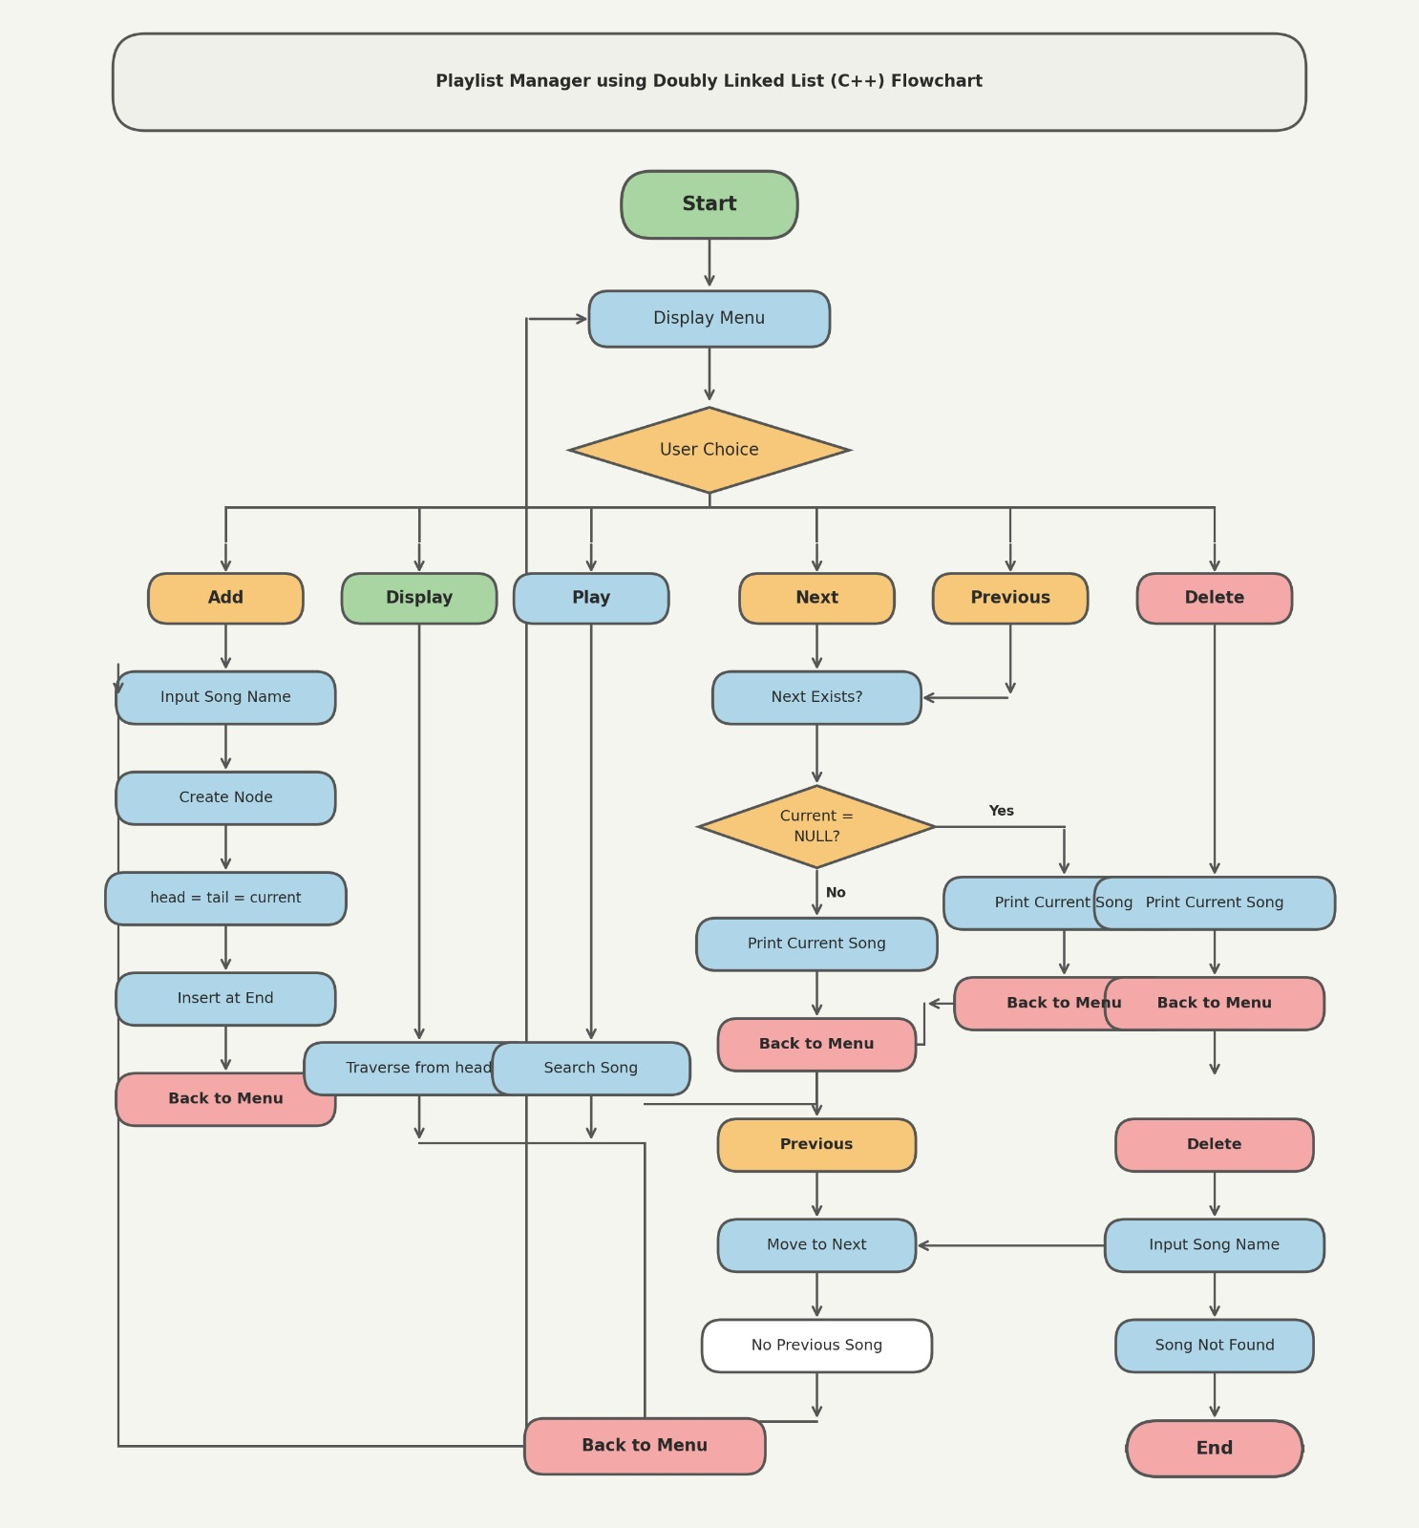
Program Flowchart

Slide 8
Complete Code — main() & Input Handling
int main() {
string line, name; int choice;
while (true) {
cout << "1.Add 2.Display 3.Play";
cout << "4.Next 5.Prev 6.Del 7.Exit";
getline(cin, line); // No cin>> used!
choice = line.empty() ? 0 : line[0]-'0';
switch(choice) {
case 1: getline(cin,name); addSong(name); break;
case 2: display(); break;
case 3: playCurrent(); break;
case 4: nextSong(); break;
case 5: prevSong(); break;
case 6: getline(cin,name); deleteSong(name); break;
case 7: return 0;
default: cout << "Invalid option\n";
}
}
Key fix: getline() used everywhere — no cin>> — supports multi-word song names!

Slide 9
Features & Sample Output
Add Song
Supports multi-word names like 'Shape of You'
Display
Shows entire playlist, marks current with >>
Play
Prints the currently playing song
Next / Prev
Navigate forward and backward
Delete
Removes song, safely updates current pointer
Sample Output
Playlist: Blinding Lights >> Shape of You (current) Hotel California

Slide 10
Thank You
Playlist Manager using Doubly Linked List — C++
Key Takeaways
✦ Doubly Linked List enables O(1) navigation between adjacent songs
✦ Three global pointers (head, tail, current) manage the full playlist state
✦ getline() input handling supports real-world song names with spaces
✦ Delete logic safely handles head, tail, middle, and current node cases
github.com | C++ | Data Structures | DSA Project

